Slide 1
Writing Models in SasView
A Contributing to SasView workshop Tutorial
Paul Butler
Virtually Dec 9, 2021

Slide 2
Program
Just in case … a bit about what SasView is today
What the program “is” and “is not”
What the program can do
SasView support resources available
A bit of historical background and current status
The SasView collaborative model
Quizz: What is the shape of the future?
Tutorial:
Very brief Introduction
a step by step walk through
from: general equation
To: reparameterization
… and everything in between?
For complete
See YouTube channel video by Steve King!!:
https://www.youtube.com/watch?v=Sbzf_wdlPnQ
Scripting Tutorial next Thursday, Dec 16
Led by Wojciech Potrzebowski

Slide 3
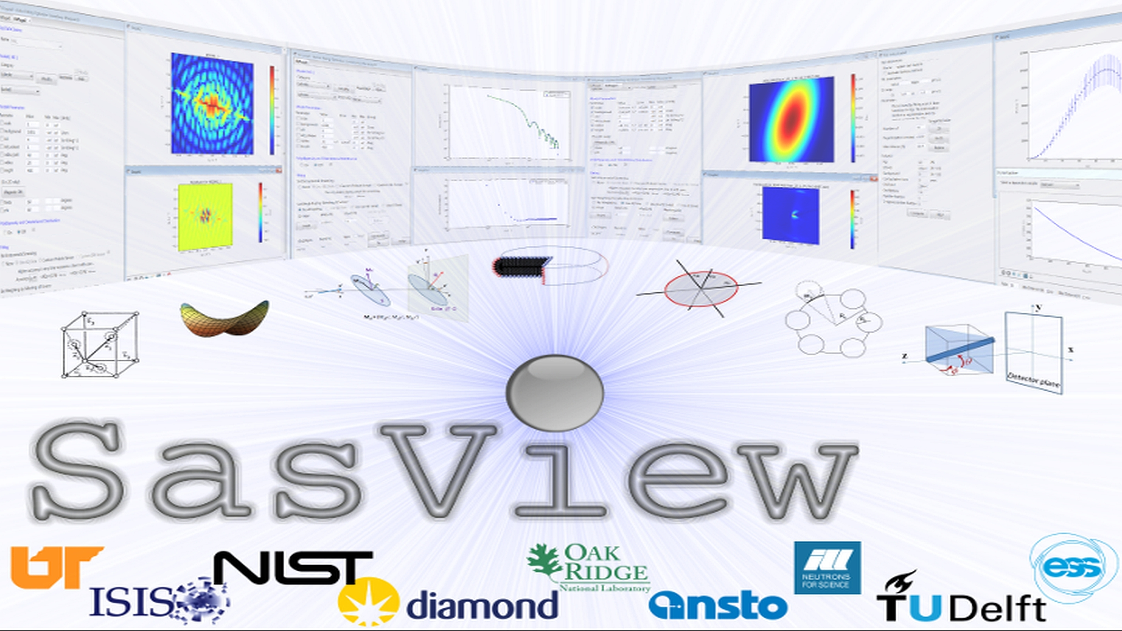
A platform for
Small Angle Scattering Data Analysis

Slide 4
SasView
Data Analysis eh?
…. So what exactly does that mean?
Only works on Reduced data
(All the instrumental artifacts are removed and only the science is left)
…. Sorta
Focus on analytical approaches for this package
…. Sorta
Whatever anybody puts into it
…. Sorta

Slide 5
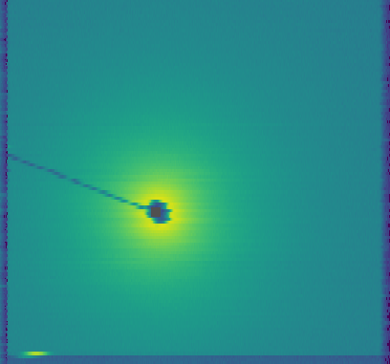
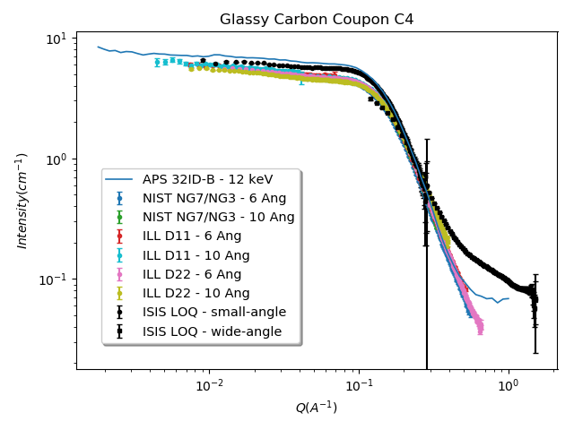
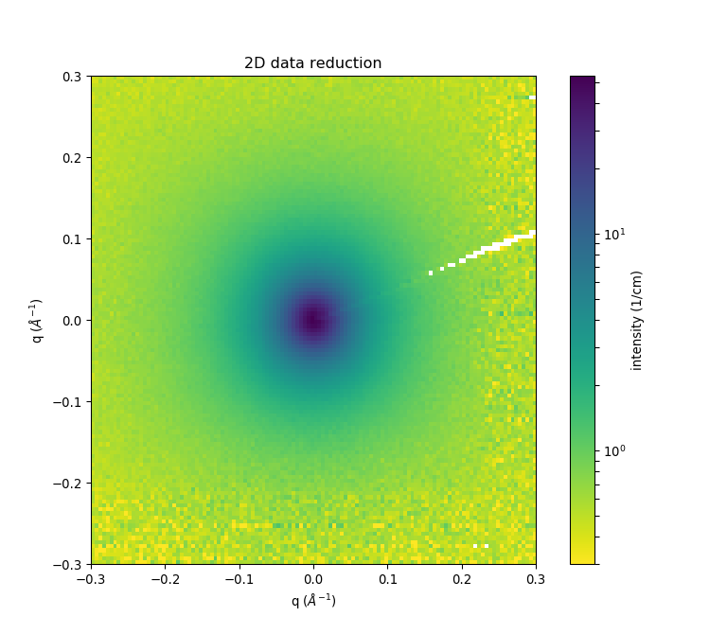
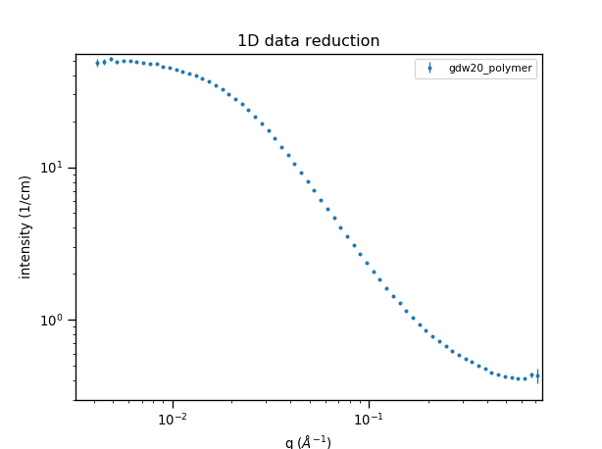
Experimental Data Flow
Reduced data should be reproducible anywhere!
Data Acquisition System
Instrument-
dependent
data
‘raw’ data file
(NXS)
Data Reduction Programs
(e.g. Mantid)
Instrument-
independent
data
reduced data file
(1D: HDF / XML / TXT; 2D: HDF / TXT)
http://www.cansas.org
Data Analysis Programs
Paper / Thesis
Notes:
Penultimate step in a ‘data processing pipeline’

Slide 6
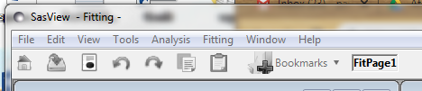

Perspectives on the data
Tools
Data Operation
SLD calculator
Density/Volume calculator
Slit Size Calculator
Kiessig Thickness Calculator
Q Resolution Estimator
Generic Scattering calculator
Orientation Viewer
Python Shell/Editor
Image Viewer
File Converter
Analysis
Fitting
Invariant
Pr Inversion
Correlation Function

Slide 7
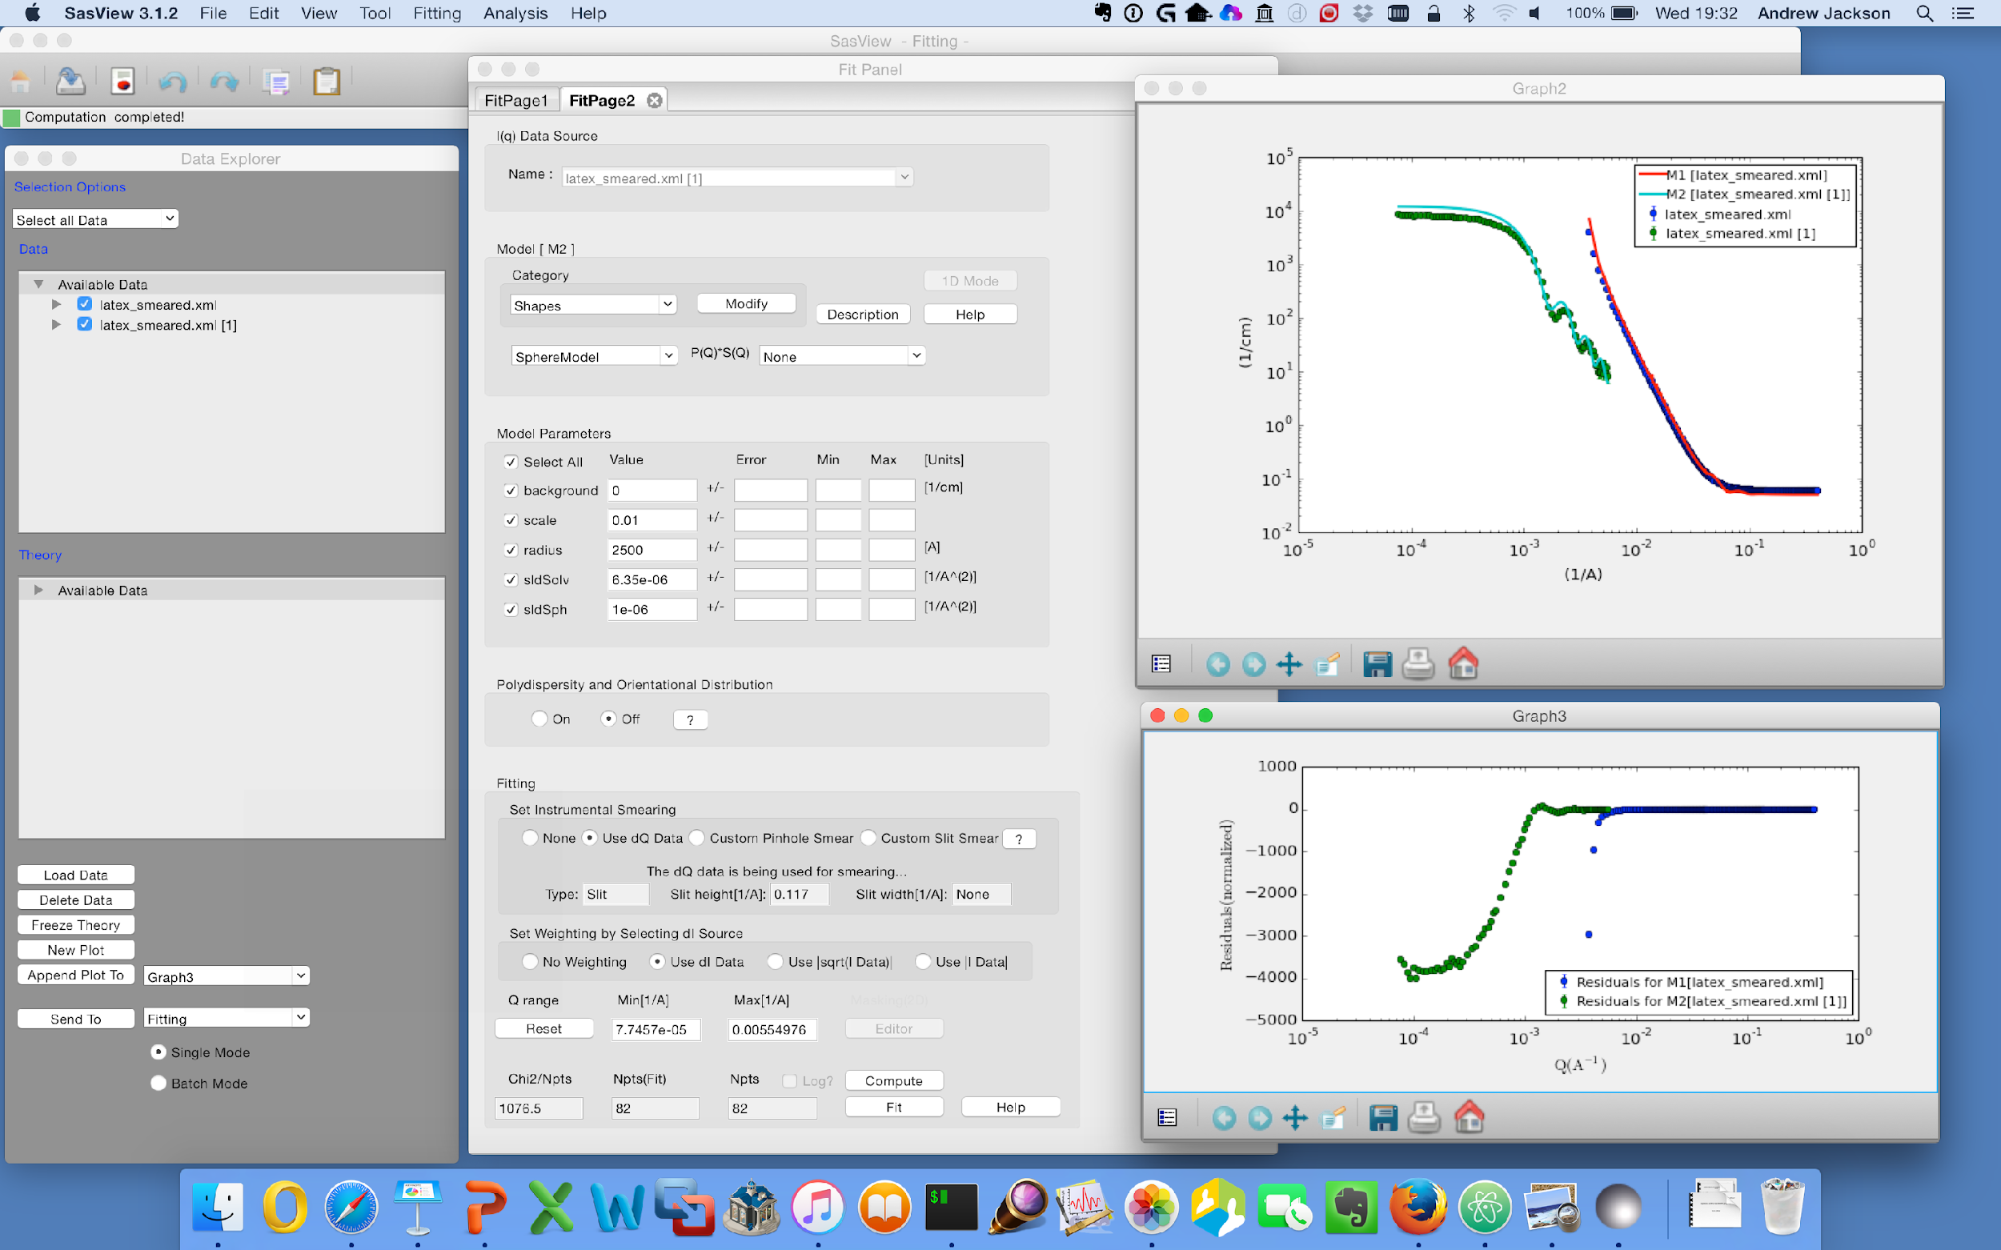
1D Analysis
Wide choice of built-in models (> 70)
P(Q), S(Q) & P(Q)*S(Q)
Simultaneous fitting
Data management
Common data formats supported, including NXCansas & cansas1D
Analysis Tool Choice
&
Plotting
Generic parameter polydispersity
Choice of distribution and distribution parameters
Resolution smearing (pinhole and slit)
Automatically from data or provide parameters

Slide 8
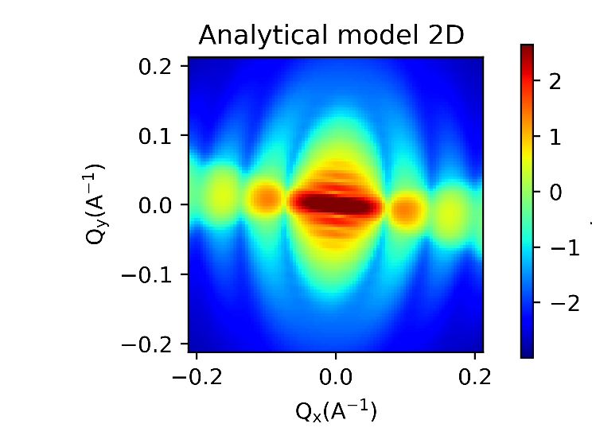
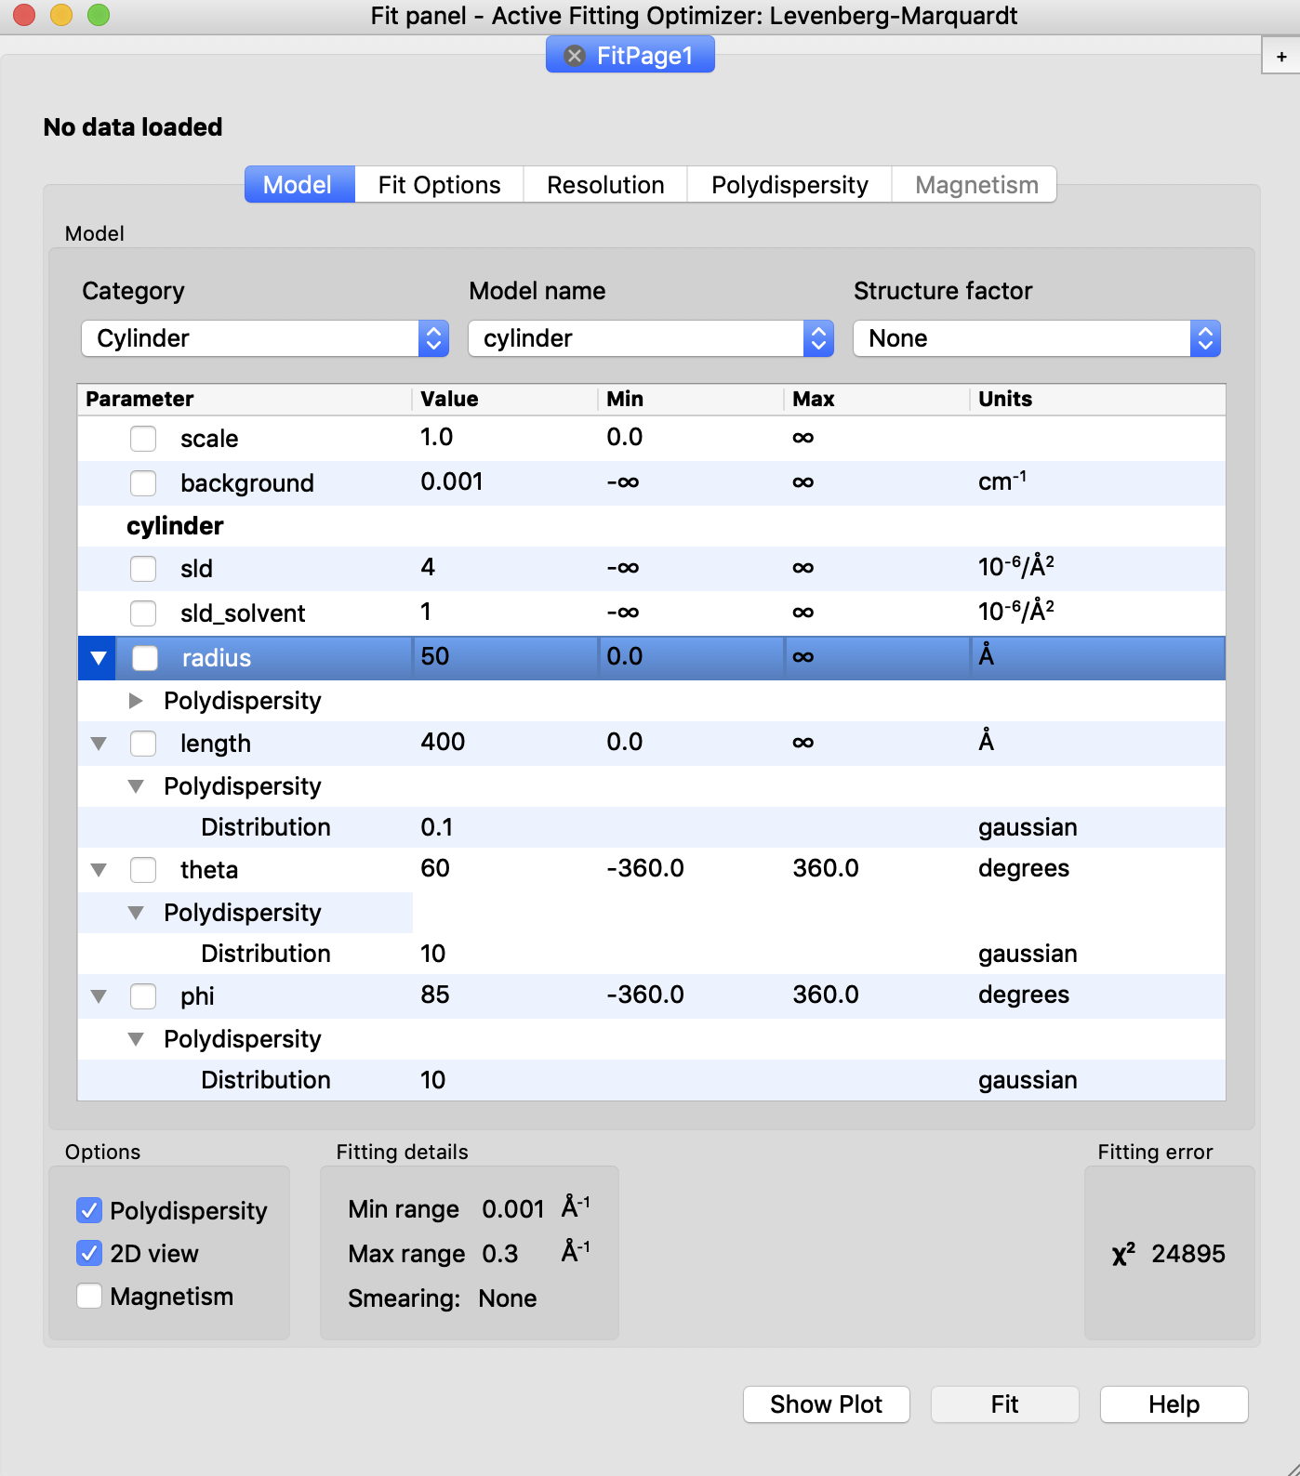
2D Analysis
Orientational polydispersity = “jitter”
Decouples the frame for the object’s orientation with respect to the beam and the “jitter” around the axis of the object.
Turning on GPU Option highly recommended for fitting

Slide 9
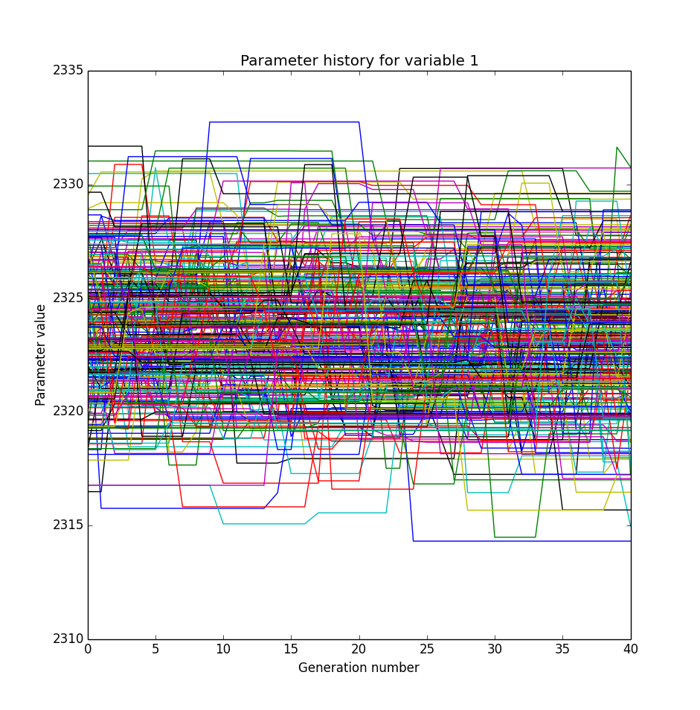
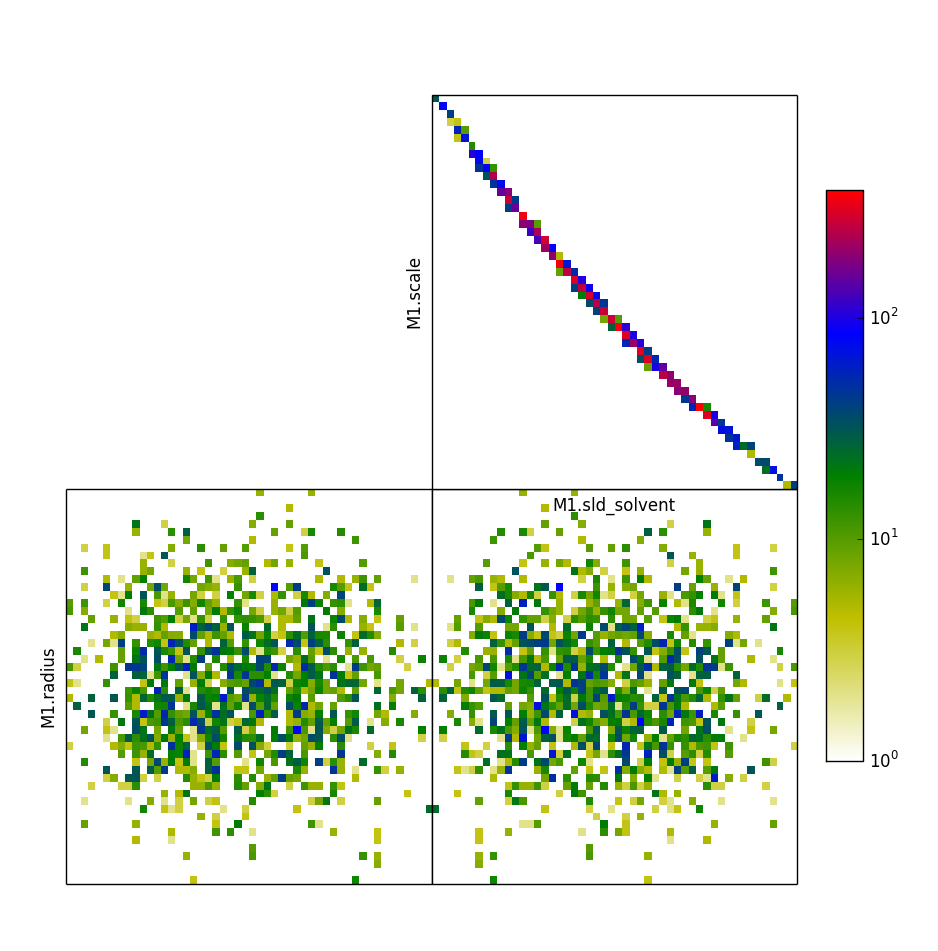
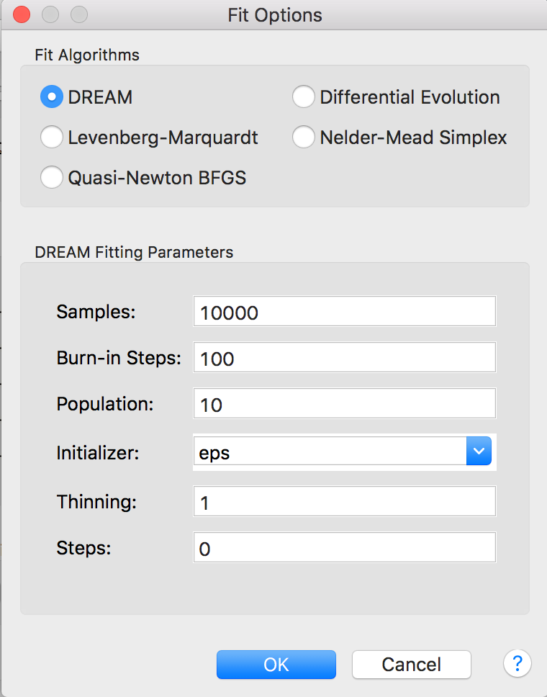
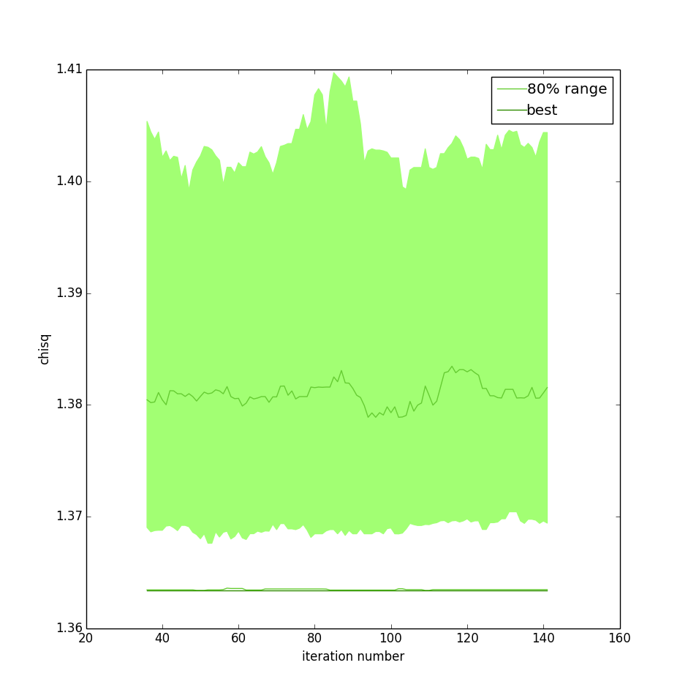
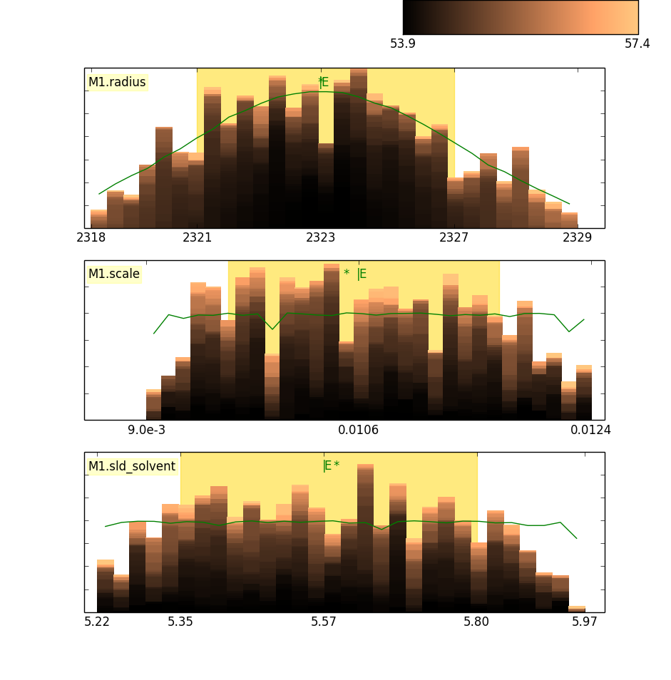
Fitting Algorithms
Uses bumps package from P. Kienzle
provides user choice of fitting engine
Conventional and Bayseian

Slide 10
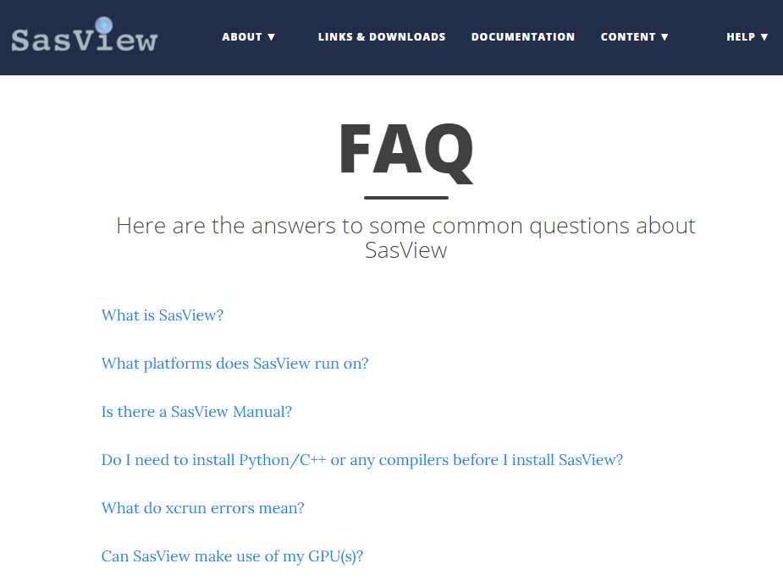
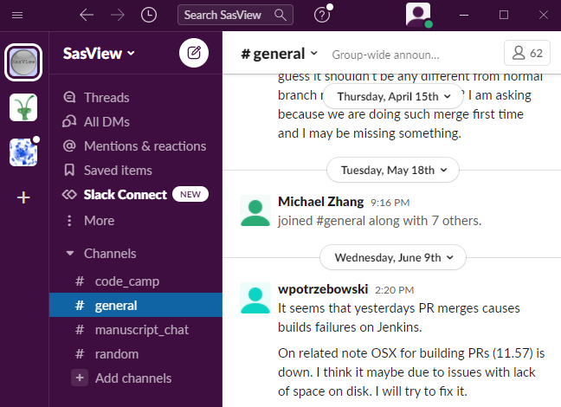
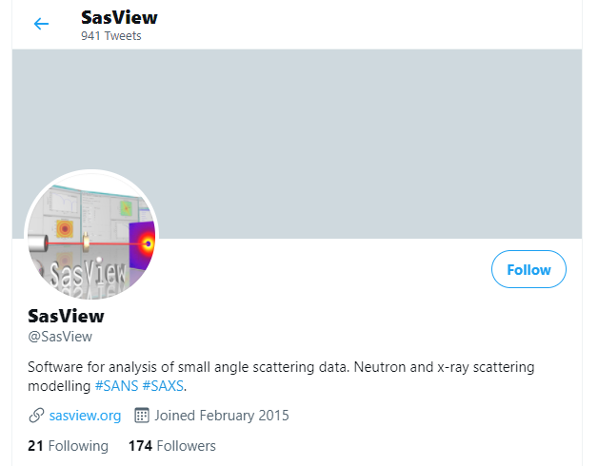
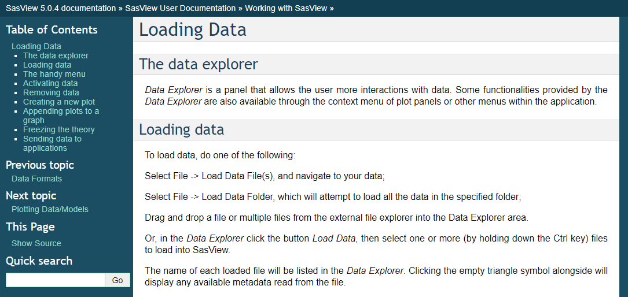
Support Resources
Website
Documentation
in-program & online
Written Tutorials
Video Tutorials (YouTube)
Taught Courses
scattering schools/workshops
university courses
Bootcamps & regional workshops
e-Learning
Slack
Twitter
(Marketplace)
help@sasview.org
users@sasview.org

Slide 11
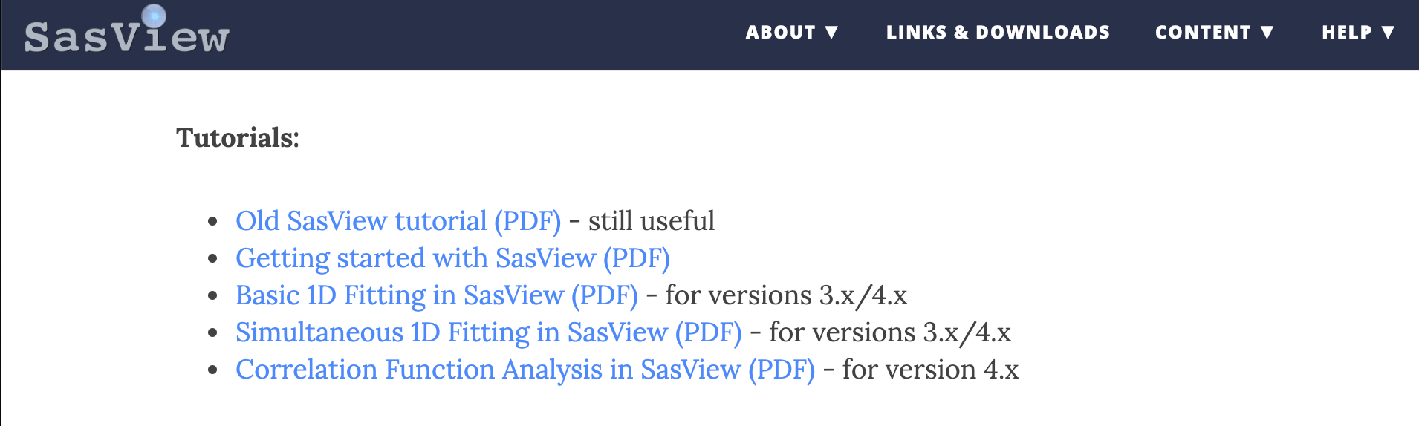
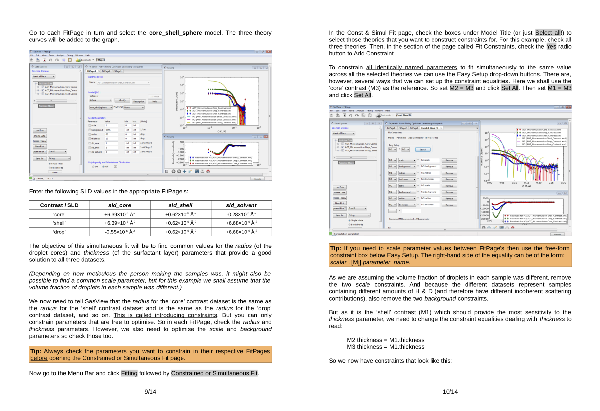
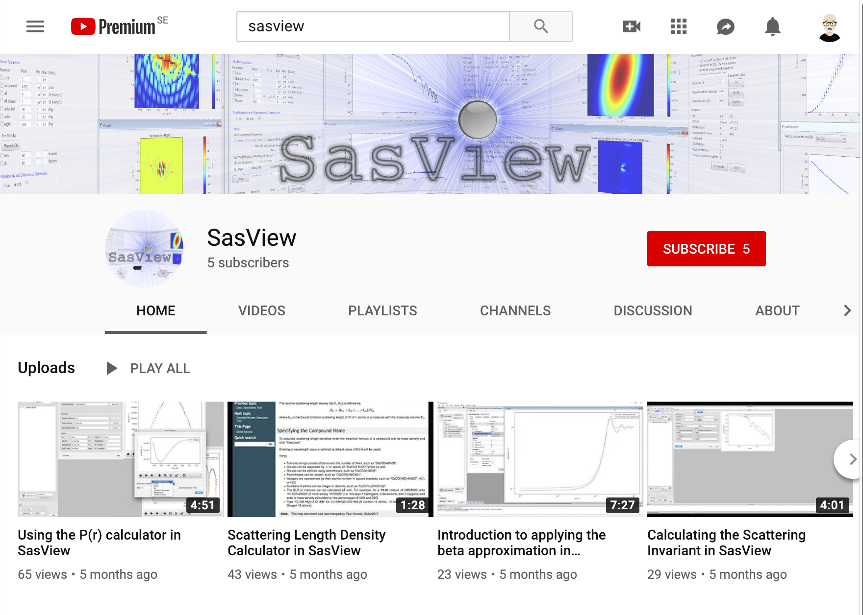
Support Resources
Website
Documentation
in-program & online
Written Tutorials
Video Tutorials (YouTube)
Taught Courses
scattering schools/workshops
university courses
Bootcamps & regional workshops
e-Learning
Slack
Twitter
(Marketplace)
help@sasview.org
users@sasview.org

Slide 12
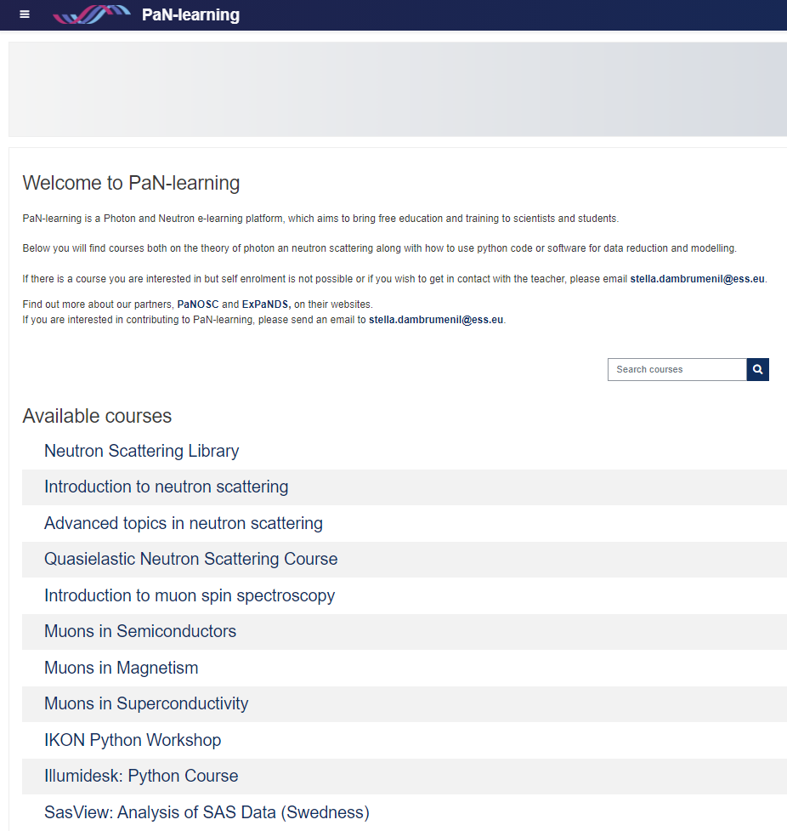

Support Resources
Website
Documentation
in-program & online
Written Tutorials
Video Tutorials (YouTube)
Taught Courses
scattering schools/workshops
university courses
Bootcamps & regional workshops
e-Learning
Slack
Twitter
(Marketplace)
help@sasview.org
users@sasview.org
https://pan-learning.org/
All the work of ISIS Sandwich Student Michael Oakley

Slide 13
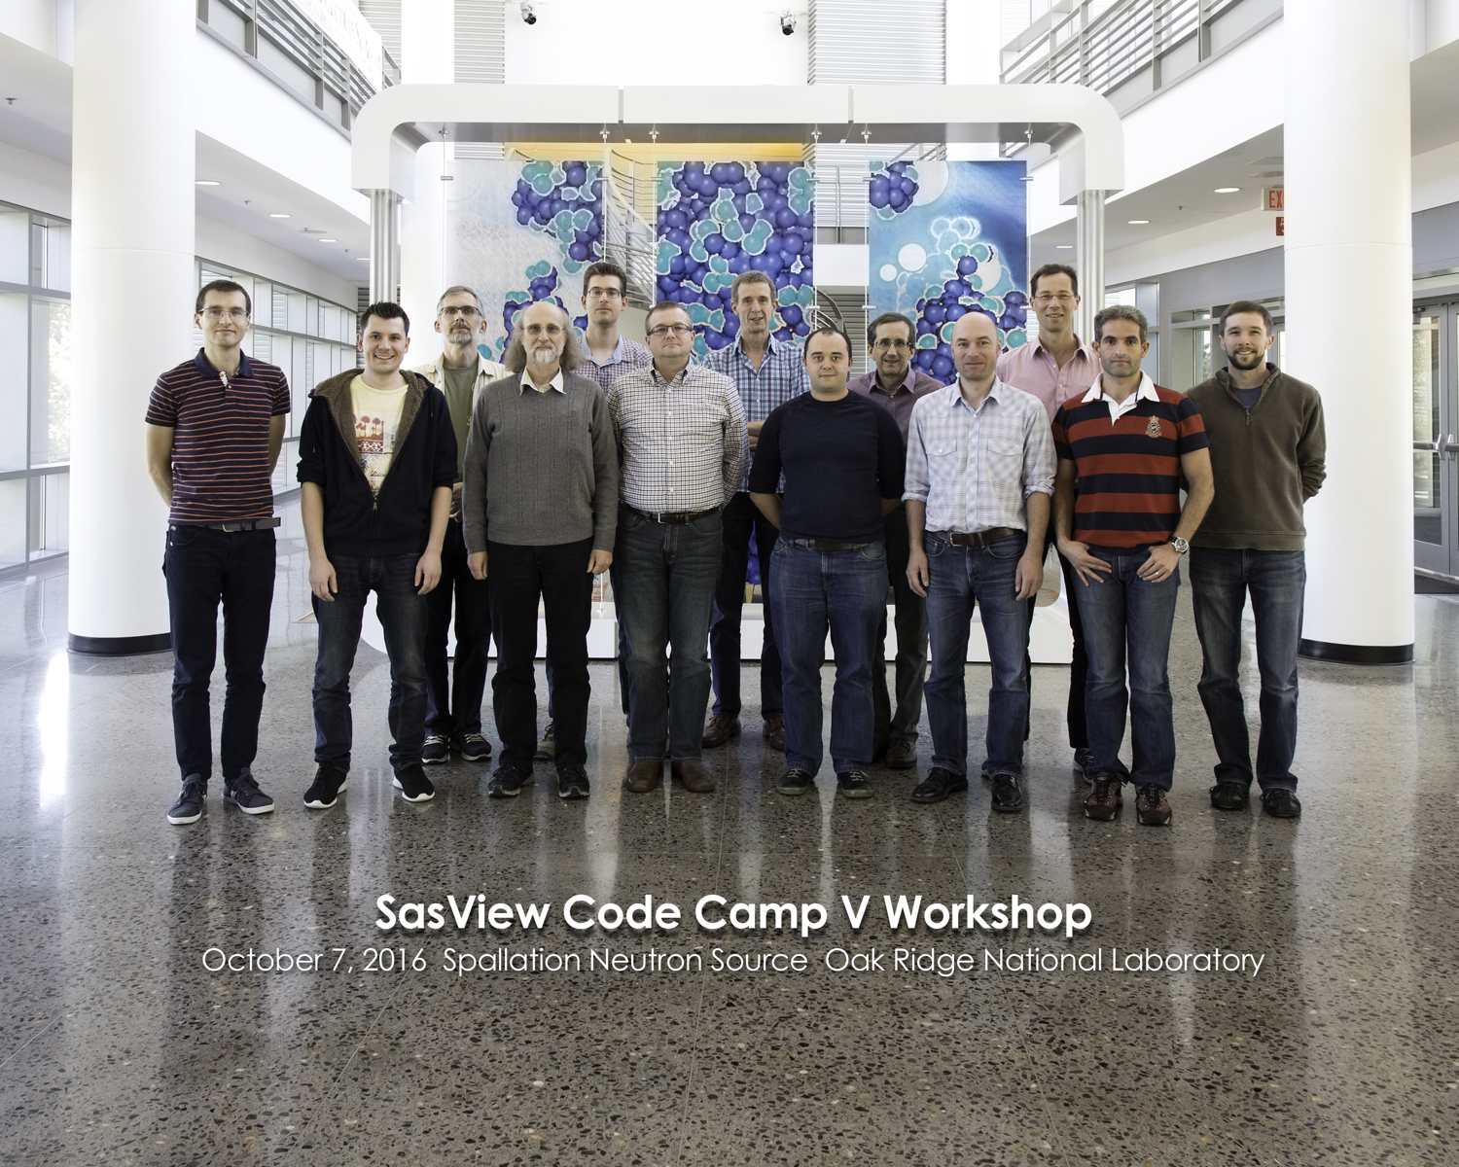
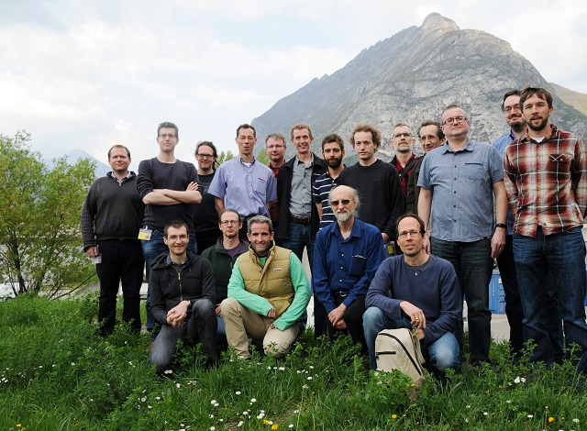
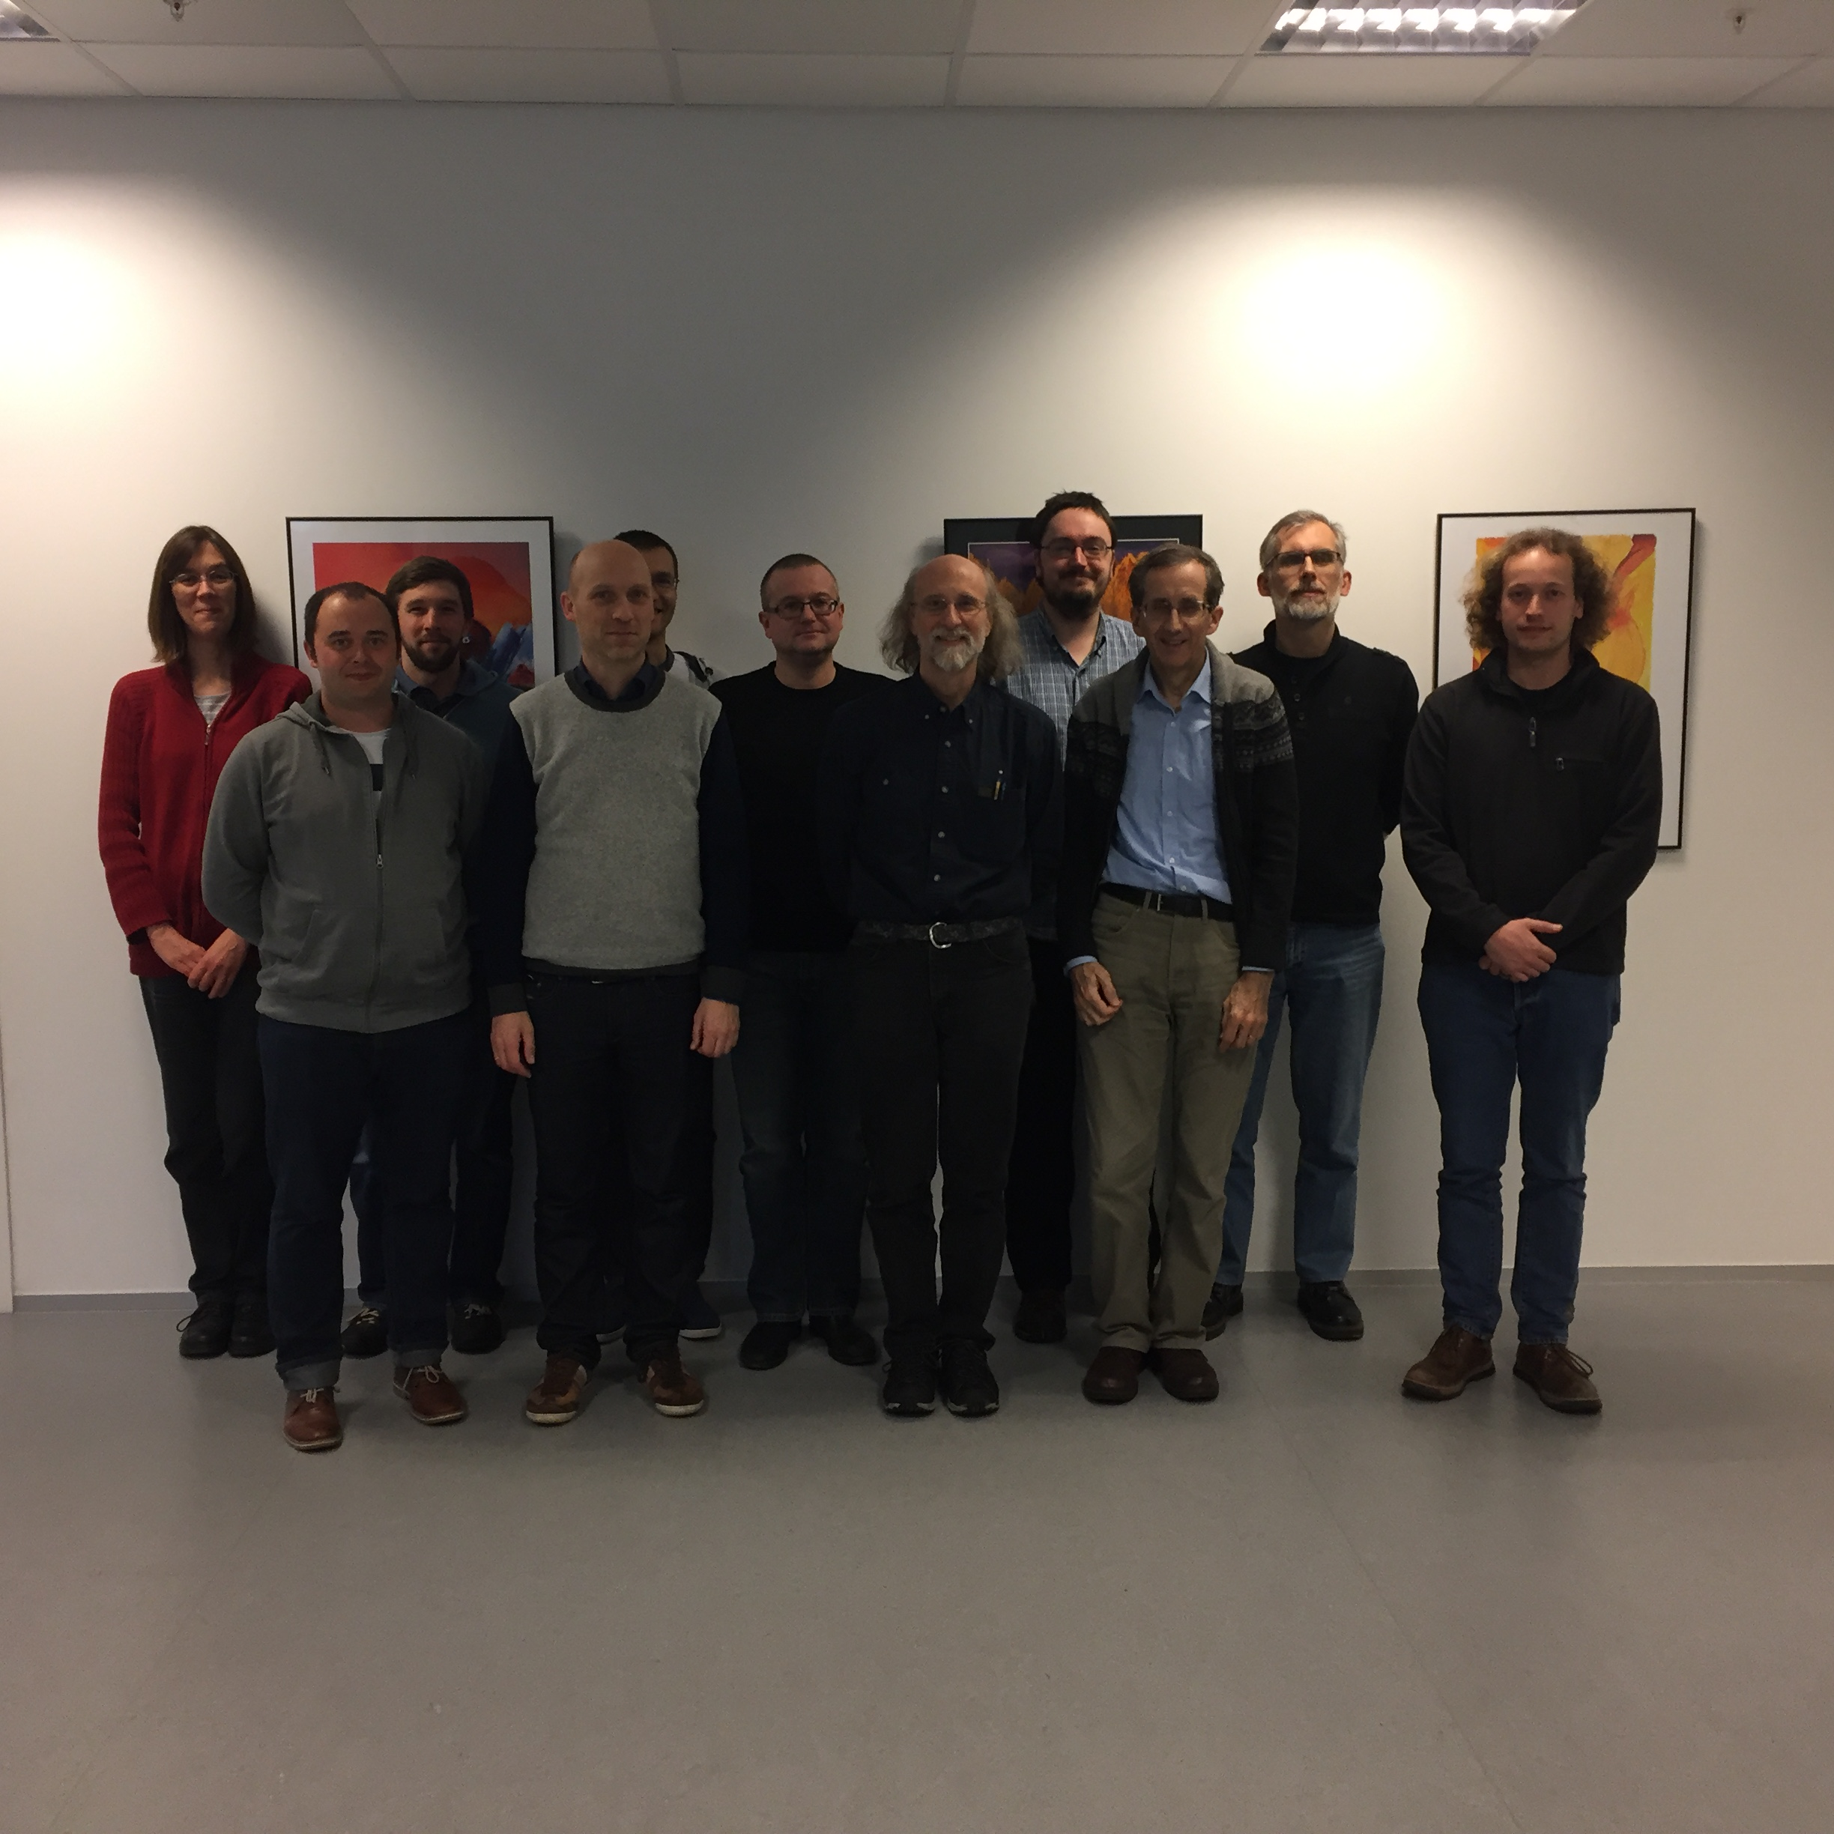
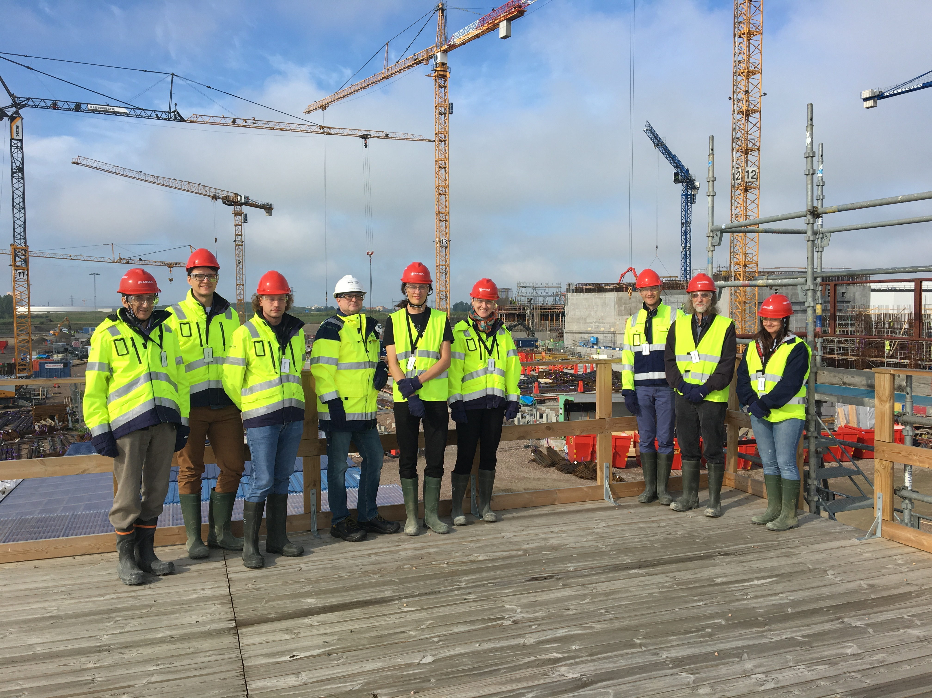
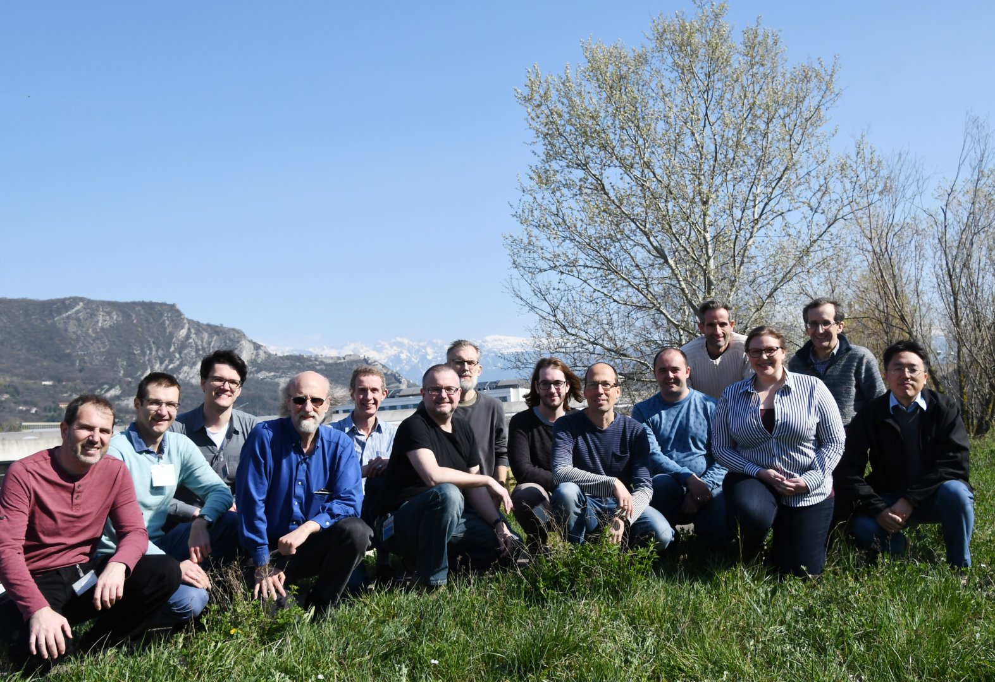
History and Status of SasView
2006; originates in NSF DANSE project
2013; transitions into a community project
2016; Sine2020 project funded
2021; Essentially a “volunteer army”
~40 contributors from 9 organisations (~15 active at any one time)
small management team:
Paul Butler (NIST), Wojciech Potrzebowski (ESS), Steve King (ISIS), [Mathieu Doucet (ORNL), Andrew Jackson (ESS)]

Slide 14
Scientific Software Development and
The cyberinfrastructure revolution
Never enough resources to achieve the vision we have
No resources for long term maintenance and support.
Problem:
To reap the benefit of investment in software developments requires foundational long term support.
If entity that supports the development also must support the "maintenance" forever, the entity will soon cease to be able to fund new projects.
CONCLUSION: This paradigm is broken!!!
FACTS OF LIFE:
Resources are finite
Needs are infinite

Slide 15
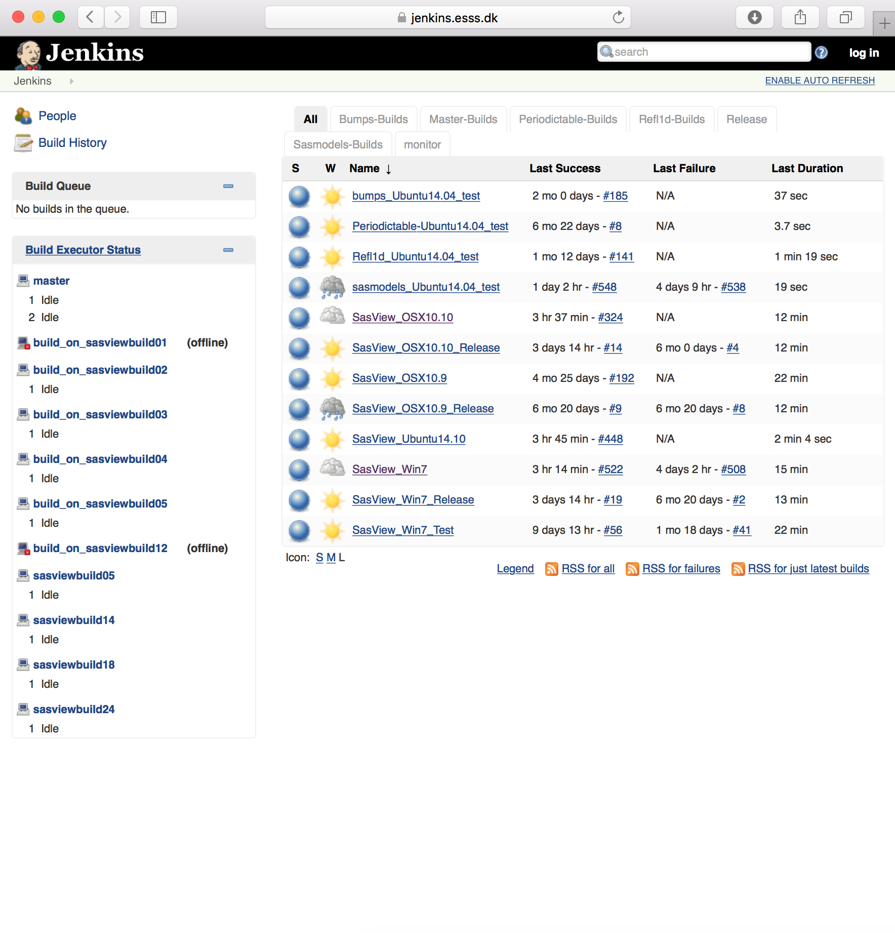
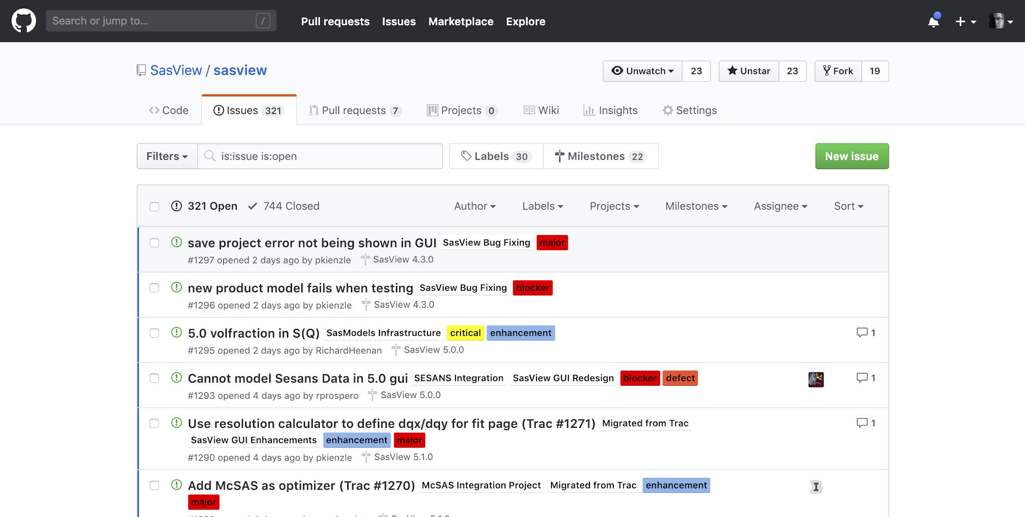
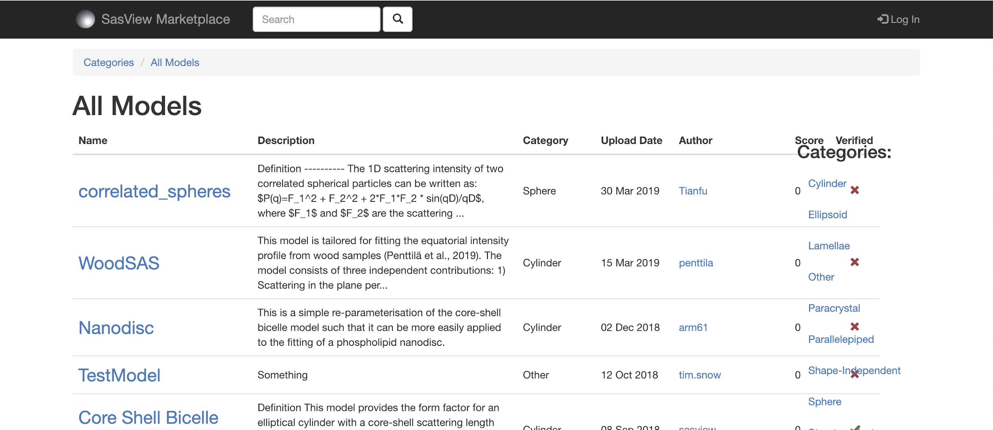

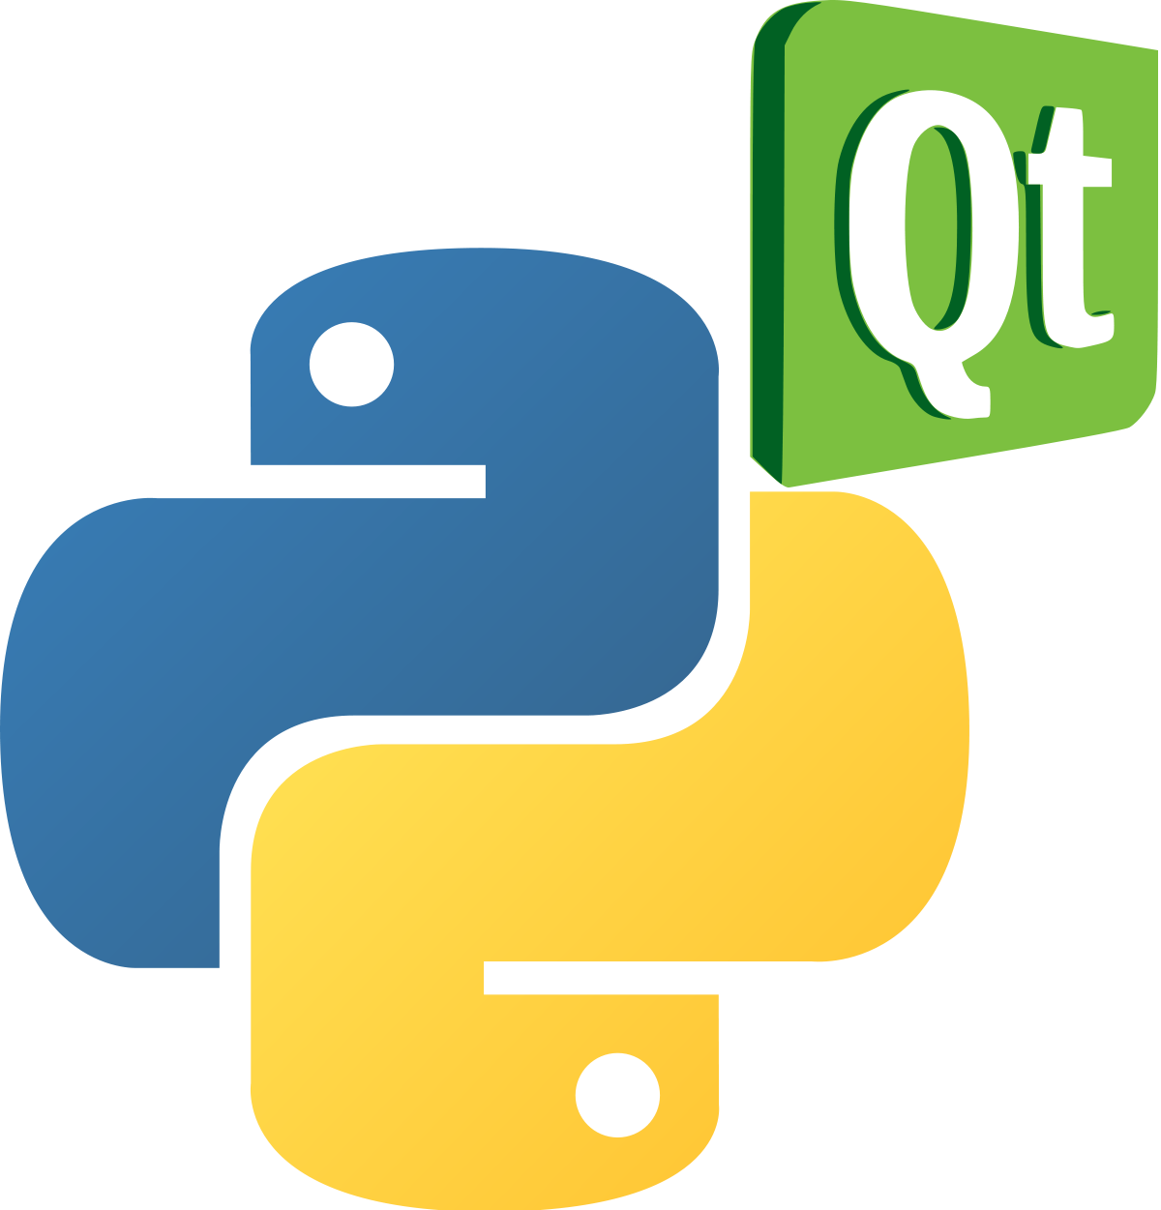

Open, Collaborative, Community Development
Code is open source and publicly hosted at Github
Released under BSD 3-clause license
DOI for each release
Rolling 5 Year Roadmap
Code Hosting, Issue Tracking & Developer Wiki on Github
Automated Builds
Model Marketplace for Users to share their models
https://github.com/SasView
http://build.sasview.org/
http://marketplace.sasview.org
https://www.sasview.org

Slide 16
Open, Collaborative, Community Development
We work together towards common goals formulated through community input, with two guiding principles ...
He who pays the piper …
Those who bring the resources (time and effort, or funds to buy time and effort) choose what to work on.
You break it, you bought it ...
You are not allowed to break what is already there for others. If you break it, you fix it.
http://www.sasview.org
http://github.com/SasView

Slide 17
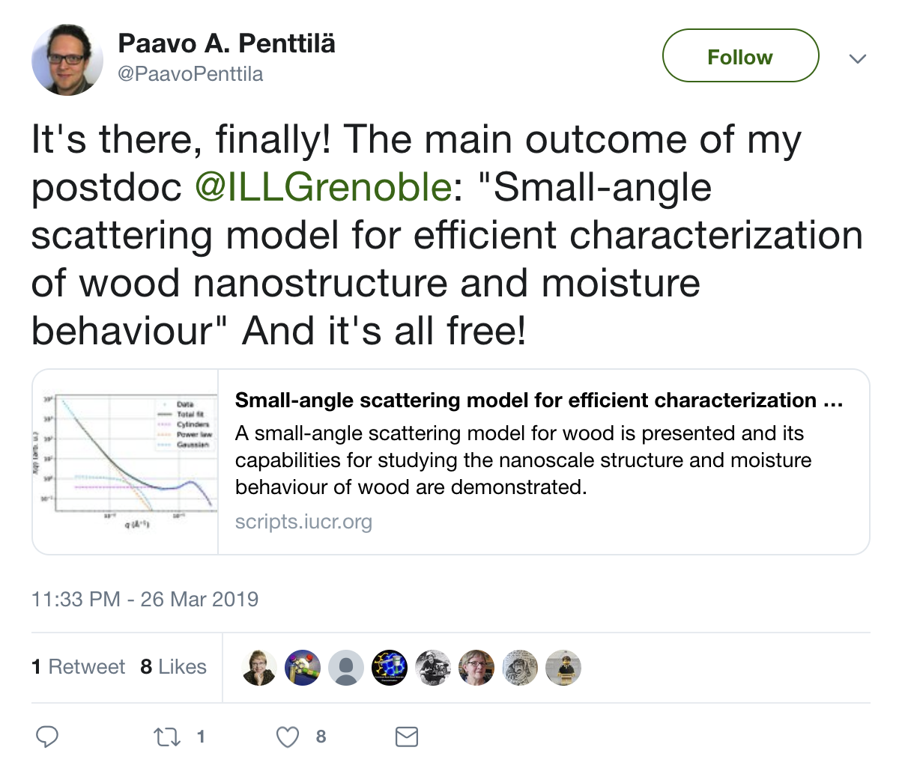
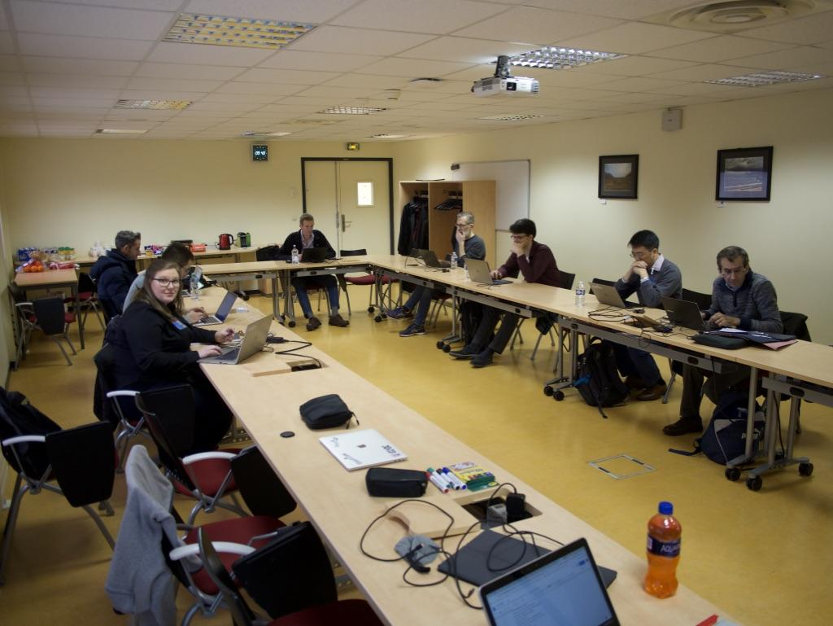
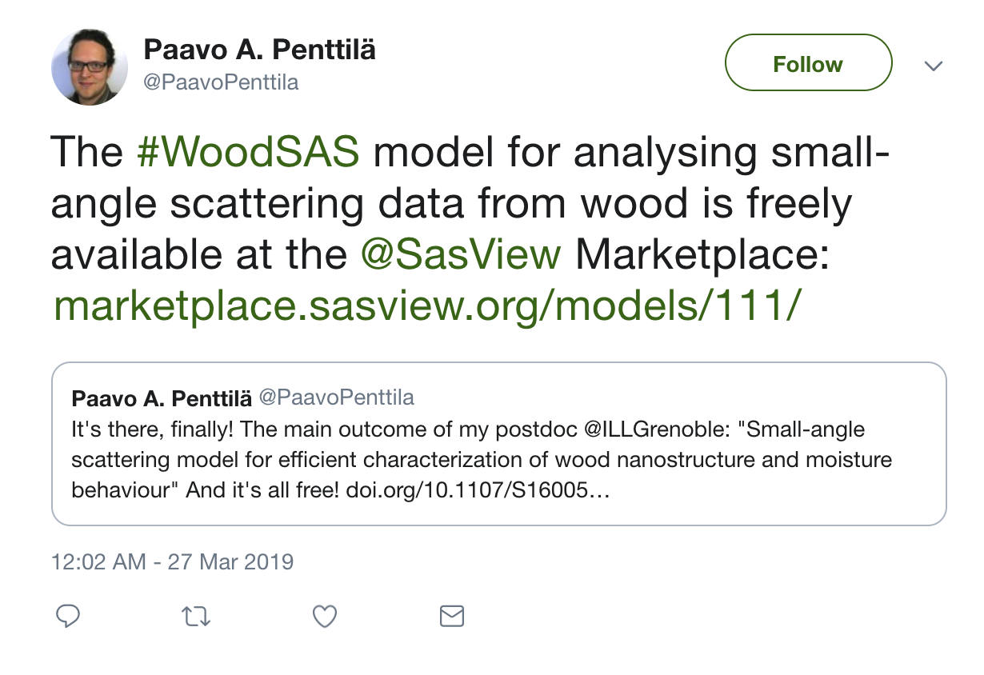
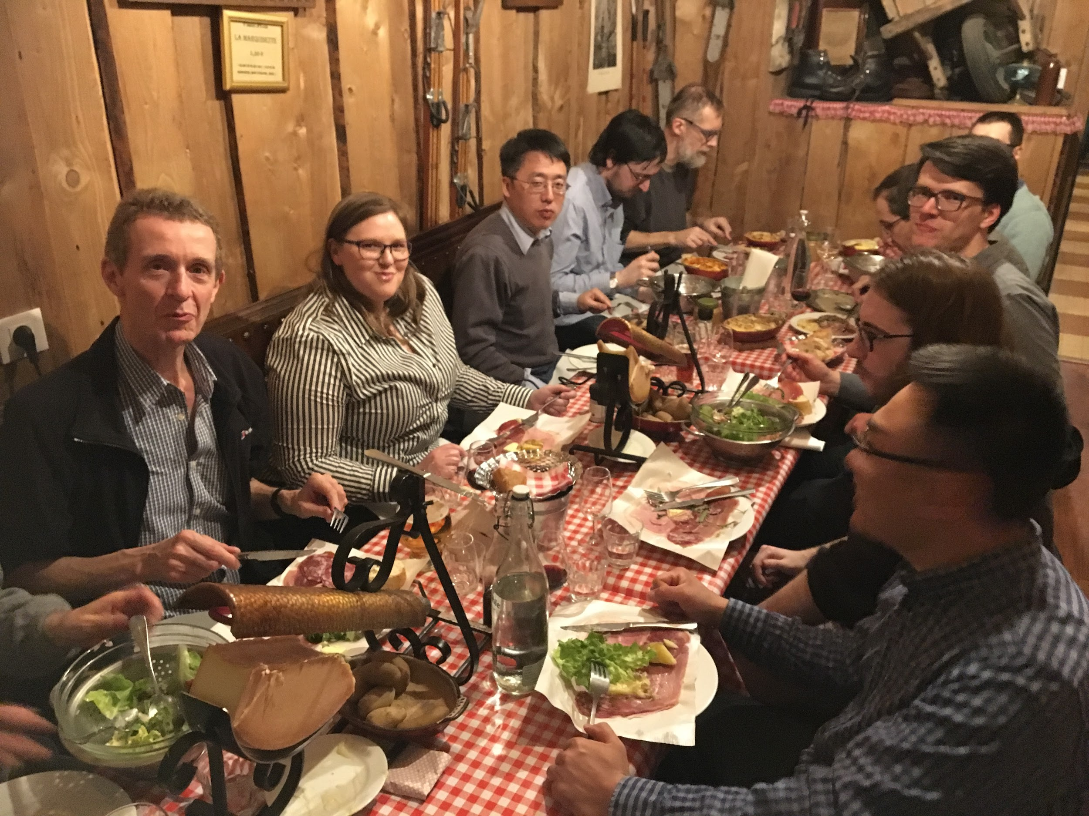
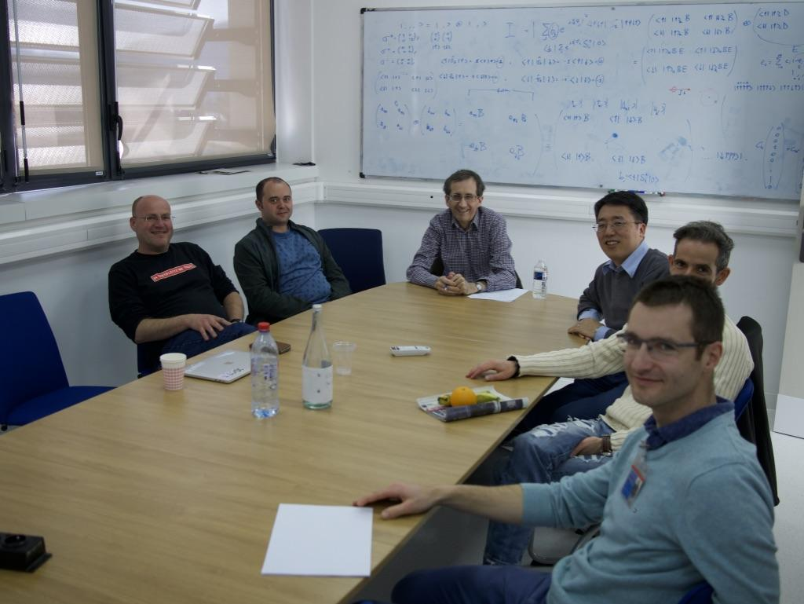
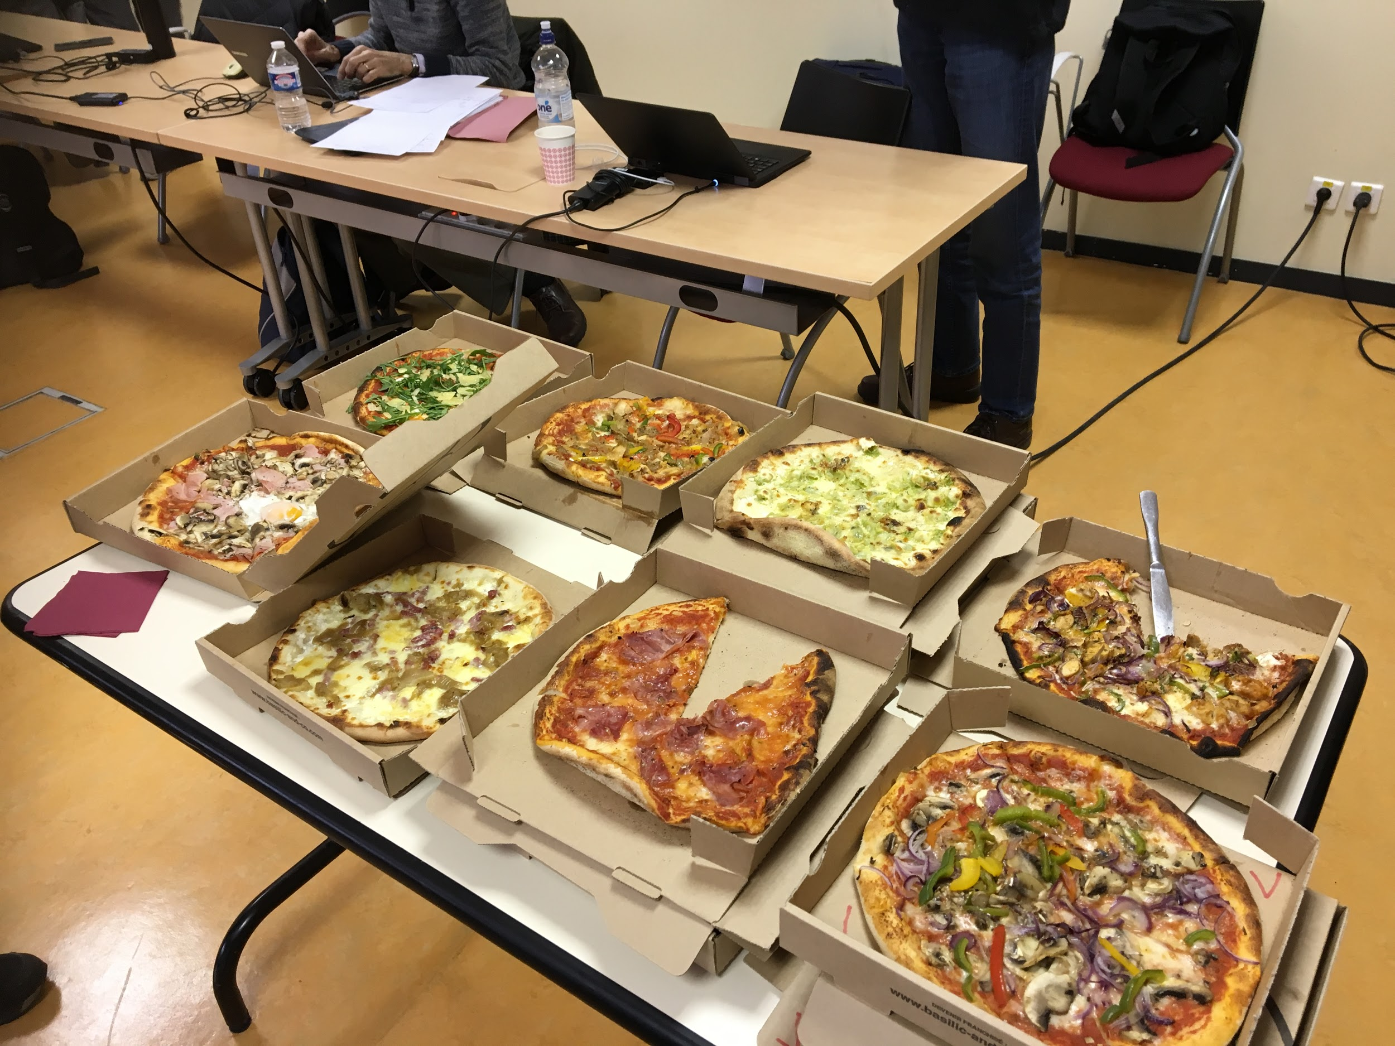
Open, Collaborative, Community Development
Twice monthly zoom calls
Regular ‘camps’ & ‘hackathons’
Ask not what the community is going to do for you,
ask what you can do for the community
P. Butler, March 2019
http://www.sasview.org
http://github.com/SasView

Slide 18
Quiz time
What will the Future SasView be able to do?

Slide 19
What to expect
We will be bold (or foolish)
and use SasView 5.0.5 beta.
No prior experience is required. However, a knowledge of SAS would be helpful along with a knowledge of enough maths to write the necessary functions
These few slides are intended to provide a quick orientation on a couple of fundamental aspects and on the outline of the demo tutorial. They are intended to be followed immediately by a live, hands-on, demo/tour using SasView to write models.

Slide 20
SOME FUNDAMENTALS
POSTULATE: creating a new model in SasView is EASY
There is ZERO difference between built in model files and custom/plugin model files.
But there are some differences in how the GUI handles them…
You do NOT need anything but SasView to create a model
Though it may help for complicated things ….
You must know:
The equation you want to use (I(Q) = ….. what?)
What are the adjustable parameters in that model
…. And then the complexities of polydispersity, orientation, integer parameters, “multiplicity” etc.

Slide 21

MORE FUNDAMENTALS
POSTULATE: creating a new model in SasView is EASY
There are three types of model files that can be used (ALL include mymodel.py). We will only cover two of them.
NOTE: SasView provides “magic” and tools specific to SAS data, and the models and GUI make assumptions about the data being SAS data. HOWEVER, fundamentally, SasView can fit/model any data with any equation that can be given analytically (DLS? Reflectivity? )
NOTE3: SasView 4.2 is no longer being worked on and will soon be obsolete.

Slide 22
THE PLAN
POSTULATE: creating a new model in SasView is EASY
Write a simple python model (MODEL TYPE I) with no polydispersity
Rewrite using special functions (and even other packages, e.g.scipy)
Add polydispersity and the form_volume function
Enable use with structure factor (effective radius)
Rewrite in C (MODEL TYPE II and III)
Using (and creating) C library functions
Using cylinder model to look at orientation.
Use of various other flags
MAYBE .. multiplicity and Reparameterization…. A powerful new tool
How to make the model available immediately to the community

